Slide 1
OHMS LAW
FORMULAS , ( V , I , R , P )

Slide 2
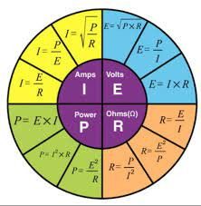
CIT ,1st Year CIT-134

Slide 3
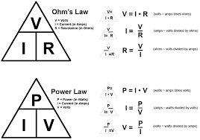
CIT ,1st Year CIT-134

Slide 4

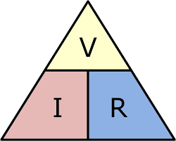
CIT ,1st Year CIT-134

Slide 5


CIT ,1st Year CIT-134

Slide 6
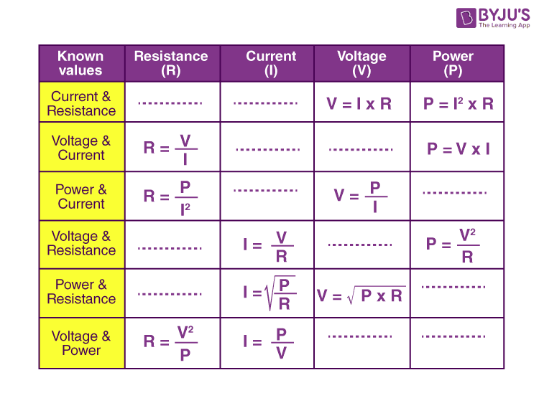
CIT ,1st Year CIT-134

